Slide 1

SIT1302 Internet Programming
UNIT 1
MARKUP LANGUAGE
Ms.J.S.Vimali
SIT1302 School of Computing

Slide 2
External Style Sheets
An external style sheet is used to define the style for many HTML pages.
To use an external style sheet, add a link to it in the <head> section of each HTML page.
The external style sheet can be written in any text editor. The file must not contain any HTML code, and must be saved with a .css extension.
Example
<!DOCTYPE html>
<html>
<head>
<link rel="stylesheet" href="styles.css">
</head>
SIT1302 School of Computing

Slide 3
<!DOCTYPE html>
<html>
<head><title>EXTERNAL STYLE SHEET</title>
<link rel="stylesheet" href="exstyle.css" type="text/css">
</head>
<body>
<h1><center>External StyleSheet</center></h4>
<p> This program is an example of external style sheet.And has a separate file called exstyle with .css extension</p>
<big>This is in smaller font</big><br>
<small>This is in larger font</small>
</body>
</html>
SIT1302 School of Computing

Slide 4
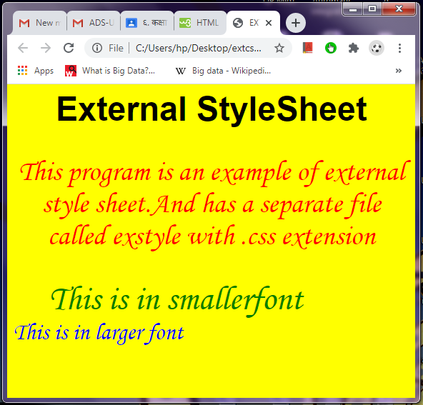
OUTPUT
h1{
font-size:35pt;
font-family:Arial;
color:black;}
body{
font-size:30pt;
font-family:monotype corsiva;
color:green;
background-color:yellow;}
p{
font-size:30pt;
text-align:center;
color:red;}
big{
margin-left:50px;
margin-right:50px;}
small{
color:blue;}
SIT1302 School of Computing

Slide 5
<!DOCTYPE html>
<html>
<head><style>
div {
background-image: url('img_girl.jpg');}
</style></head>
<body>
<h2>Background Image</h2><div>
You can specify background images<br>
for any visible HTML element.<br>
In this example, the background image<br>
is specified for a div element.<br>
By default, the background-image<br>
will repeat itself in the direction(s)<br>
where it is smaller than the element<br>
where it is specified. (Try resizing the<br>
browser window to see how the<br>
background image behaves.
</div></body></html>
Background Image on a Page
SIT1302 School of Computing

Slide 6
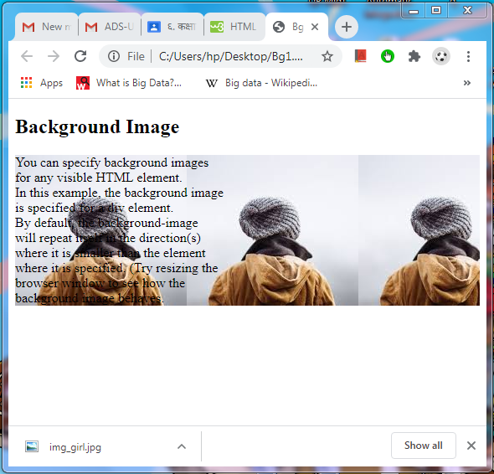
OUTPUT
SIT1302 School of Computing

Slide 7
Background Cover
<!DOCTYPE html>
<html>
<head>
<style>
body {
background-image: url('img_girl.jpg');
background-repeat: no-repeat;
background-attachment: fixed;
background-size: cover;}
</style>
</head>
<body>
<h2>Background Cover</h2>
<p>Set the background-size property to "cover" and the background image will cover the entire element, in this case the body element.</p>
</body>
</html>
SIT1302 School of Computing

Slide 8
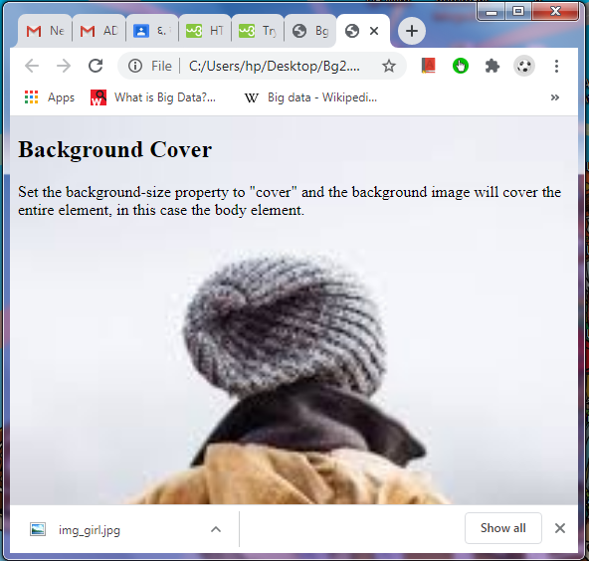
OUTPUT
SIT1302 School of Computing

Slide 9
Background Stretch
<!DOCTYPE html>
<html>
<head>
<style>
body {
background-image: url('img_girl.jpg');
background-repeat: no-repeat;
background-attachment: fixed;
background-size: 100% 100%;}
</style>
</head>
<body>
<h2>Background Stretch</h2>
<p>Set the background-size property to "100% 100%" and the background image will be stretched to cover the entire element, in this case the body element.</p>
</body>
</html>
SIT1302 School of Computing

Slide 10
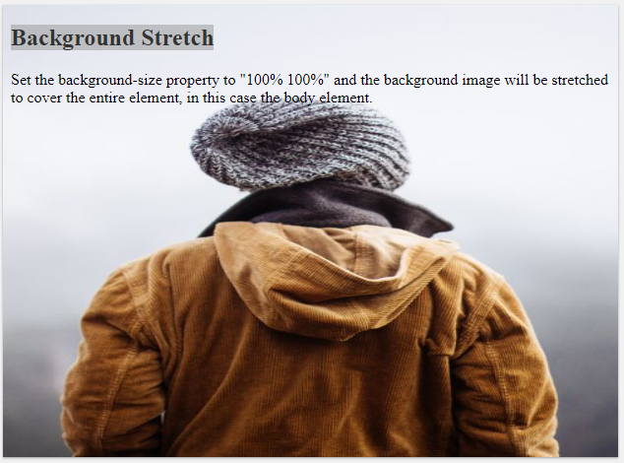
Output
SIT1302 School of Computing

Slide 11
Picture Element
<picture>
<source media="(min-width: 650px)" srcset="img_food.jpg">
<source media="(min-width: 465px)" srcset="img_car.jpg">
<img src="img_girl.jpg" style="width:auto;">
</picture>
Shows different images for different screen sizes
The HTML <picture> element gives web developers more flexibility in specifying image resources.
The <picture> element contains one or more <source> elements, each referring to different images through the srcset attribute. This way the browser can choose the image that best fits the current view and/or device.
Each <source> element has a media attribute that defines when the image is the most suitable.
SIT1302 School of Computing

Slide 12
Image Maps
With HTML image maps, you can create clickable areas on an image.
The HTML <map> tag defines an image map. An image map is an image with clickable areas. The areas are defined with one or more <area> tags.
The image is inserted using the <img> tag. The only difference from other images is that you must add a usemap attribute:
<img src="workplace.jpg" alt="Workplace" usemap="#workmap">
The usemap value starts with a hash tag # followed by the name of the image map, and is used to create a relationship between the image and the image map.
Then, add a <map> element.
The <map> element is used to create an image map, and is linked to the image by using the required name attribute:
<map name="workmap">
The name attribute must have the same value as the <img>'s usemap attribute.
SIT1302 School of Computing

Slide 13
Areas
Then, add the clickable areas.
A clickable area is defined using an <area> element.
Shape
You must define the shape of the clickable area, and you can choose one of these values:
    rect - defines a rectangular region
    circle - defines a circular region
    poly - defines a polygonal region
    default - defines the entire region
You must also define some coordinates to be able to place the clickable area onto the image.
Shape="rect"
The coordinates for shape="rect" come in pairs, one for the x-axis and one for the y-axis.
So, the coordinates 34,44 is located 34 pixels from the left margin and 44 pixels from the top:
SIT1302 School of Computing

Slide 14
<span> Element
Mapping
<html>
<head>
<title>MAPPING</title>
</head>
<body>
<img src="color.jpg" usemap="#shapes">
<map name="shapes">
<area shape="circle" coords=101,114,100 href="circle.html">
<area shape="rect" coords=261,64,343,142 href="rect.html">
<area shape="poly" coords=223,154,171,204,171,256,221,284,271,256,273,204 href="poly.html">
</map>
</bodY>
</html>
SIT1302 School of Computing

Slide 15
Circle
<html>
<head>
<title> circle</title>
</head>
<body>
<h3> This is a circle
</h3>
</body>
</html>
SIT1302 School of Computing

Slide 16
Rectangle
<htmL>
<head>
<title> rectangle</title>
</head>
<body>
<h3> This is a rectangle</h3>
</body>
</html>
SIT1302 School of Computing

Slide 17
Polygon
<html>
<head>
<title> polygon</title>
</head>
<body>
<h3> This is a polygon</h3>
<a href="image.bmp" target="third">image</a>
</body>
</html>
SIT1302 School of Computing

Slide 18
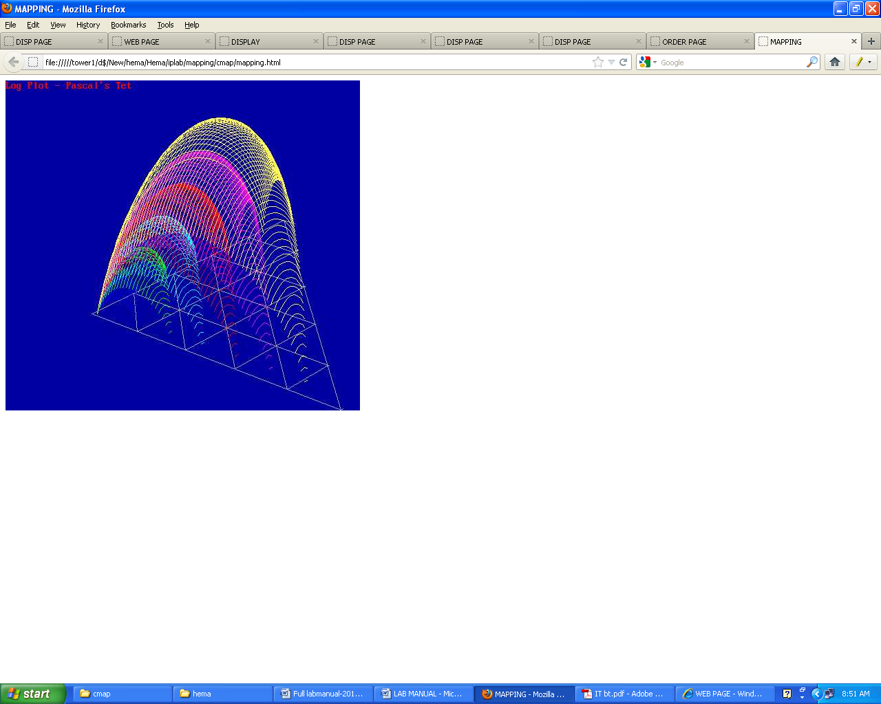
OUTPUT
SIT1302 School of Computing

Slide 19
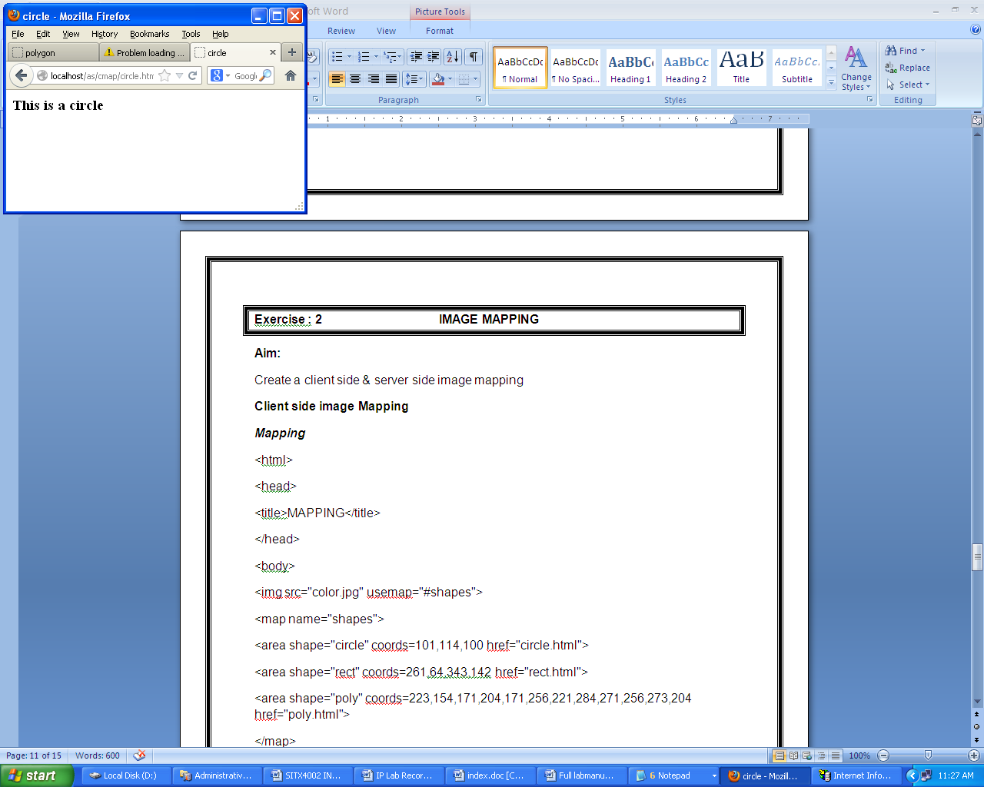
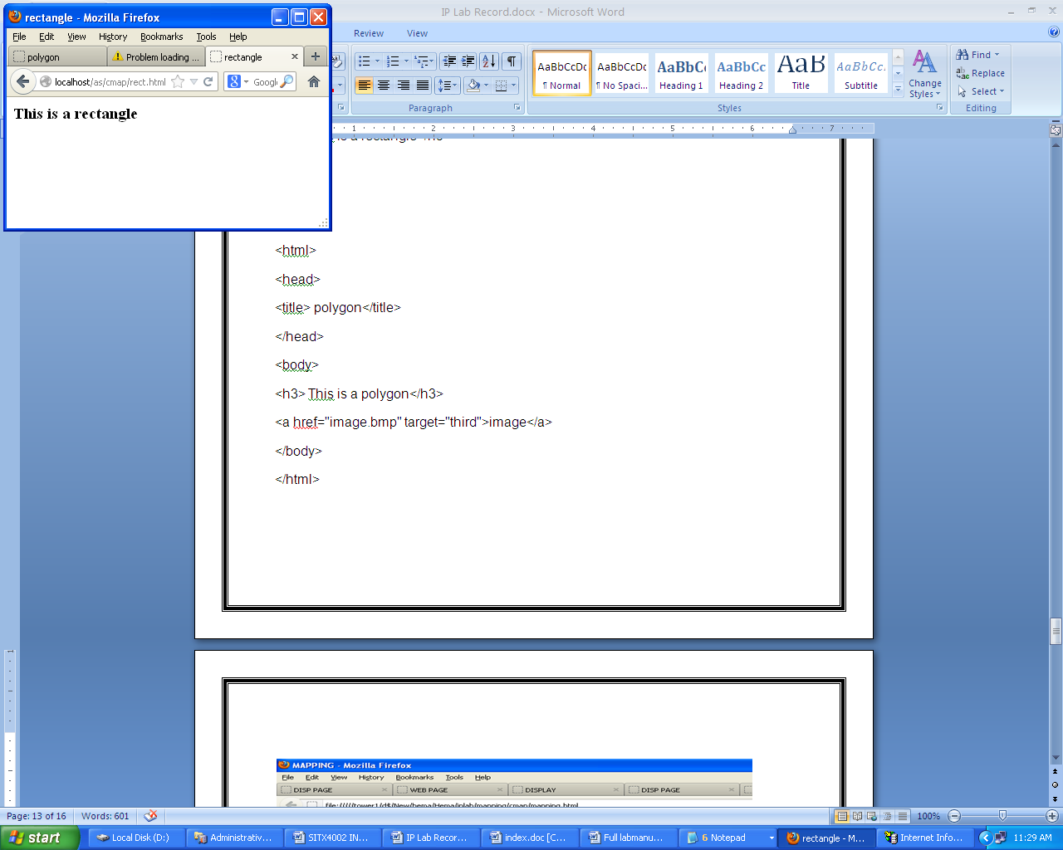
Output
SIT1302 School of Computing

Slide 20
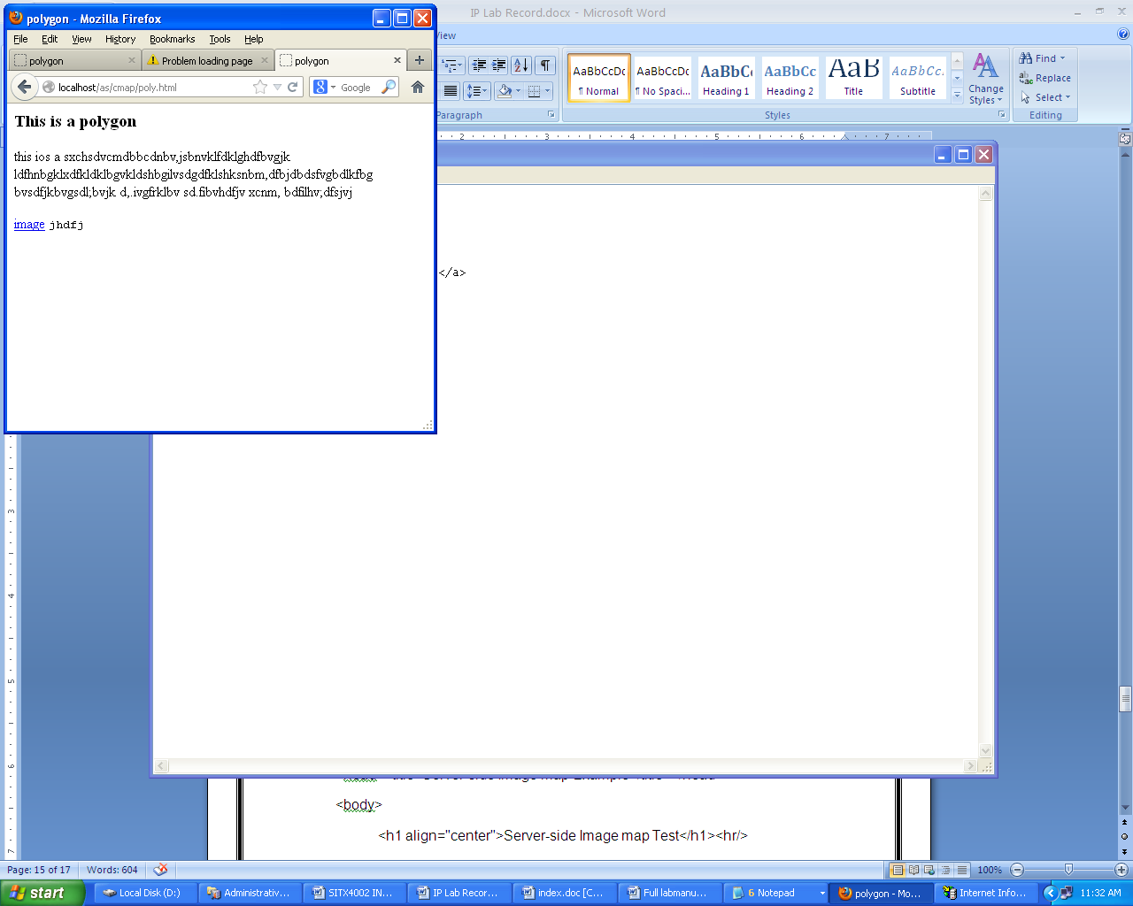
Output
SIT1302 School of Computing

Slide 21
Frames
<!DOCTYPE html>
<html>
<head>
<title>Frames</title>
</head>
<frameset rows="30%,*">
<frame src="header.html">
<frameset cols="35%,*">
<frame src="fameone.html">
<frame src="frametwo.html">
</html>
SIT1302 School of Computing

Slide 22
Frameone.html
<html>
<head>
<style>
body
{
background-image:url('img_girl.jpg');
background-repeat:no-repeat;
}
</style>
</head>
<body>
</body>
</html>
SIT1302 School of Computing

Slide 23
header.html
<html>
<body bgcolor="#D4FF33">
<a href="welcome.html">Welcome</a><br>
<a href="message.html">Message</a>
</body>
SIT1302 School of Computing

